Slide 1
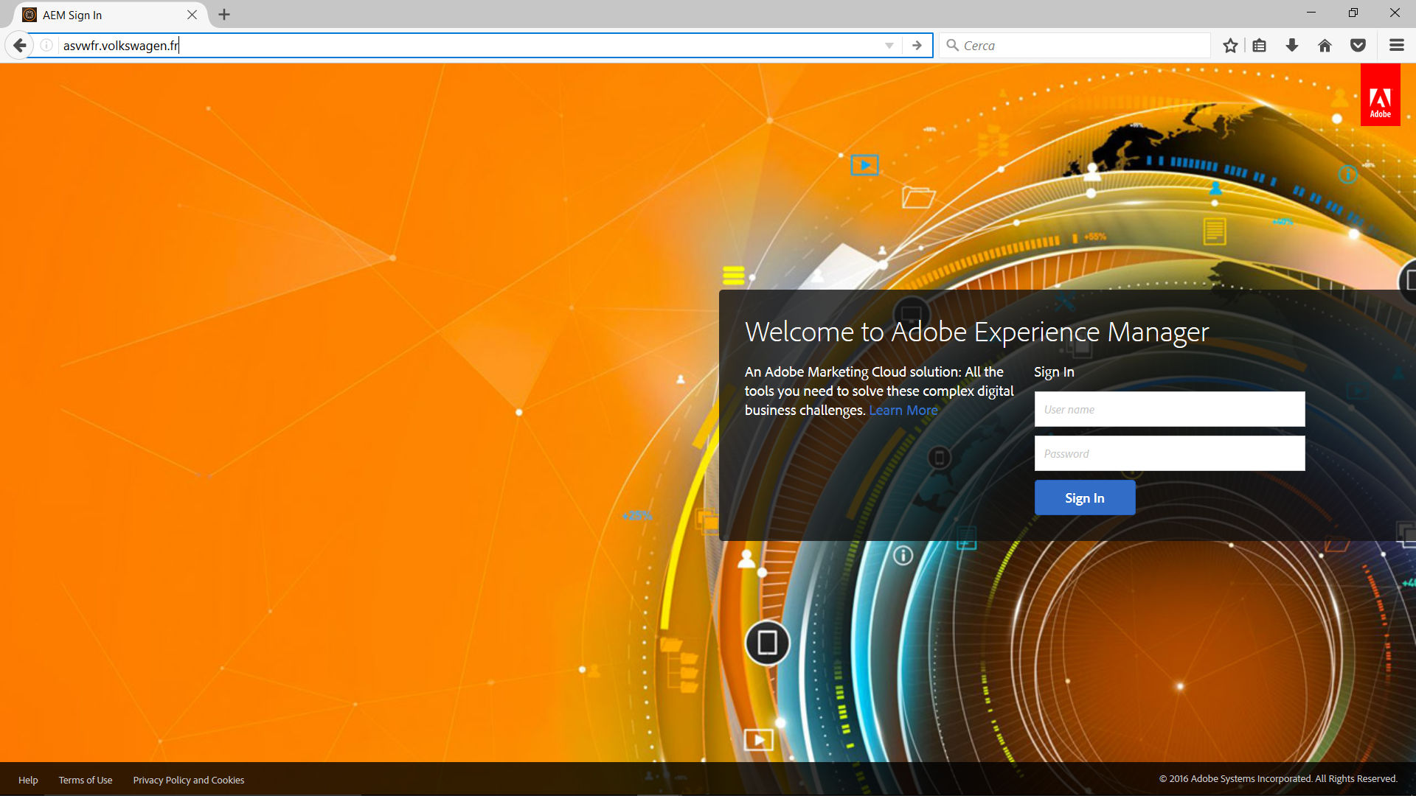
Login

Slide 2
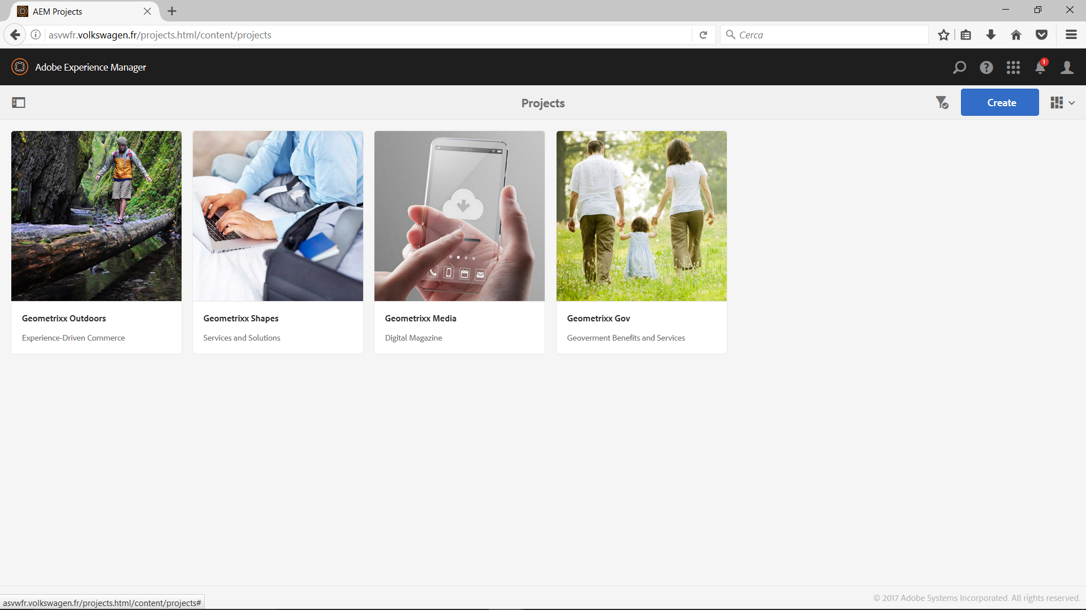
Login
Click

Slide 3
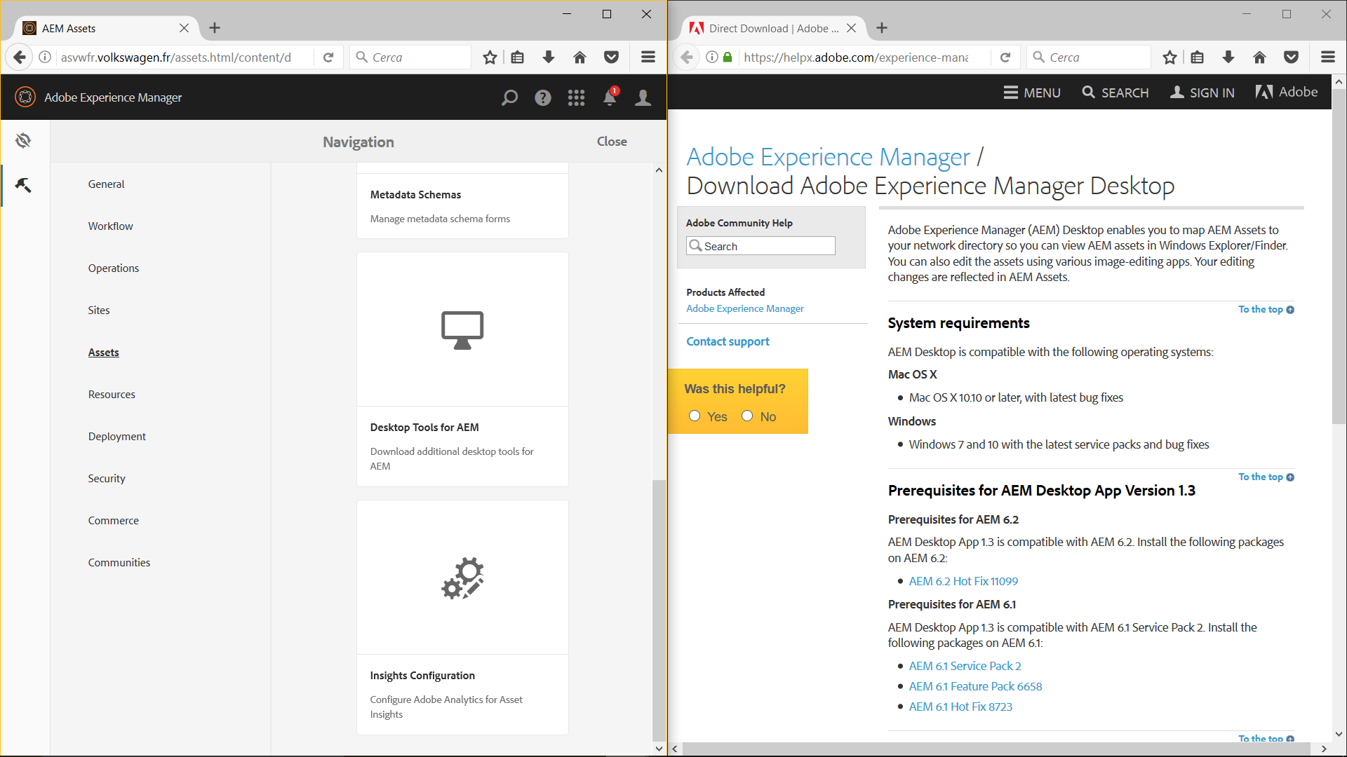
Click

Slide 4
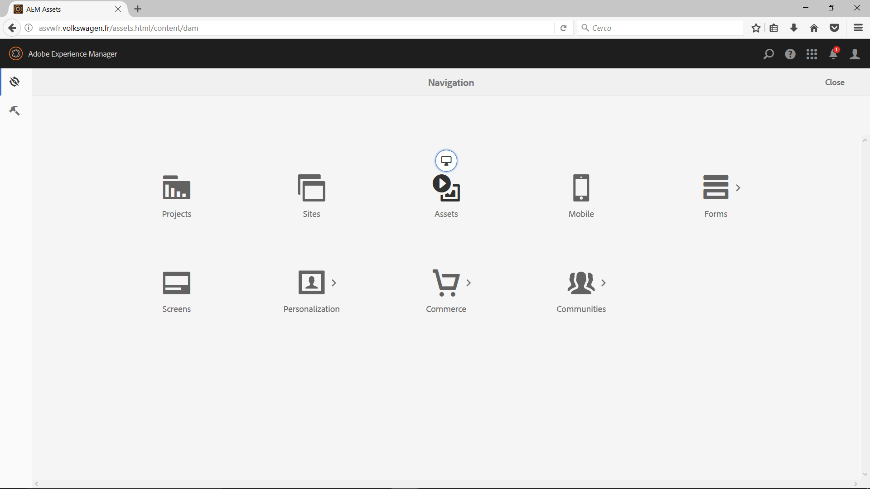
Click

Slide 5
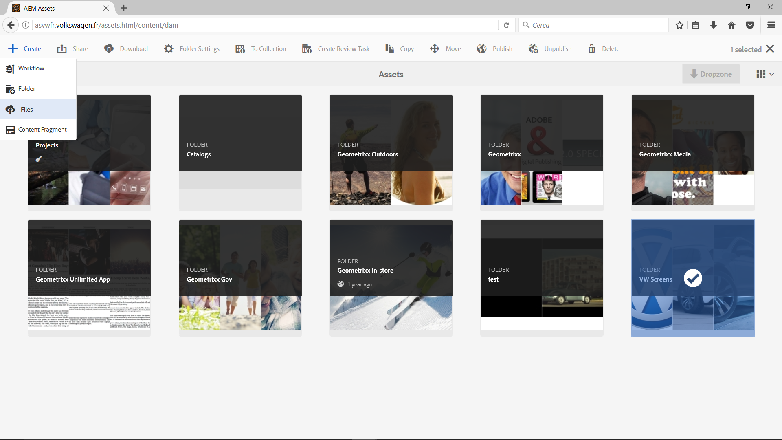
Select
Click

Slide 6
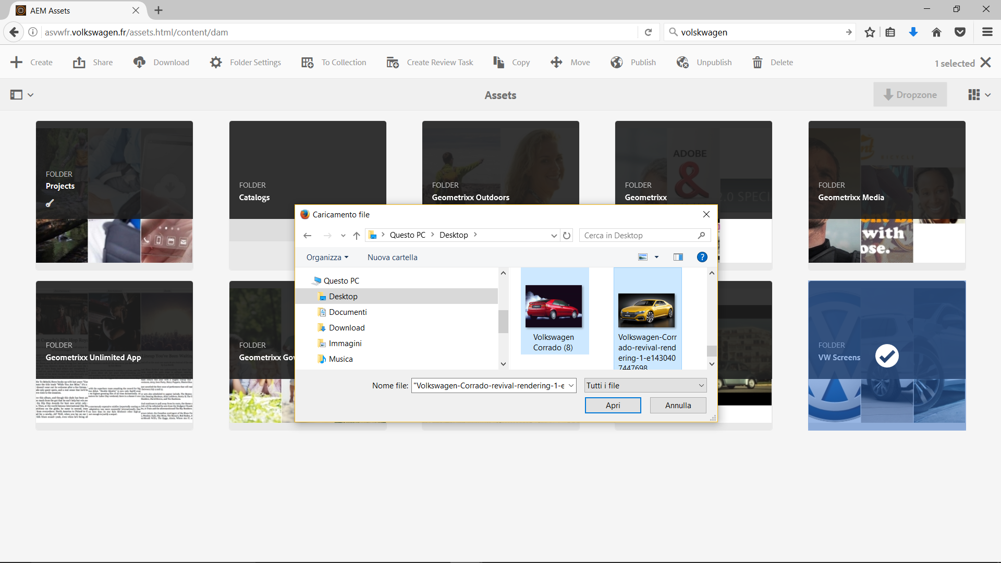
Click
Select

Slide 7
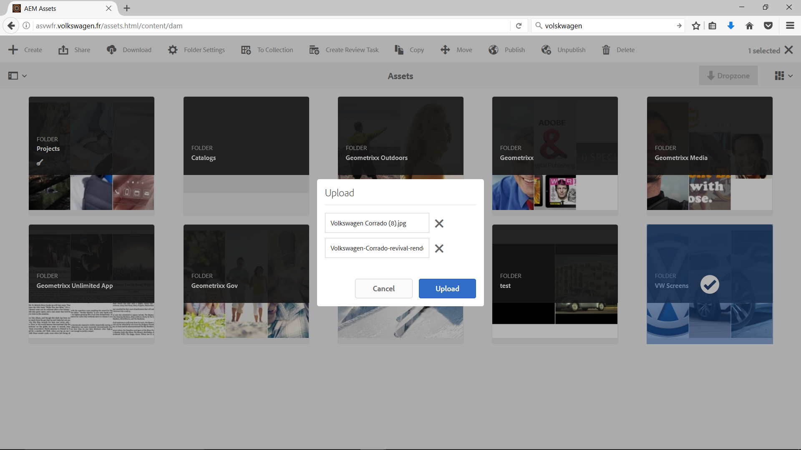
Click

Slide 8
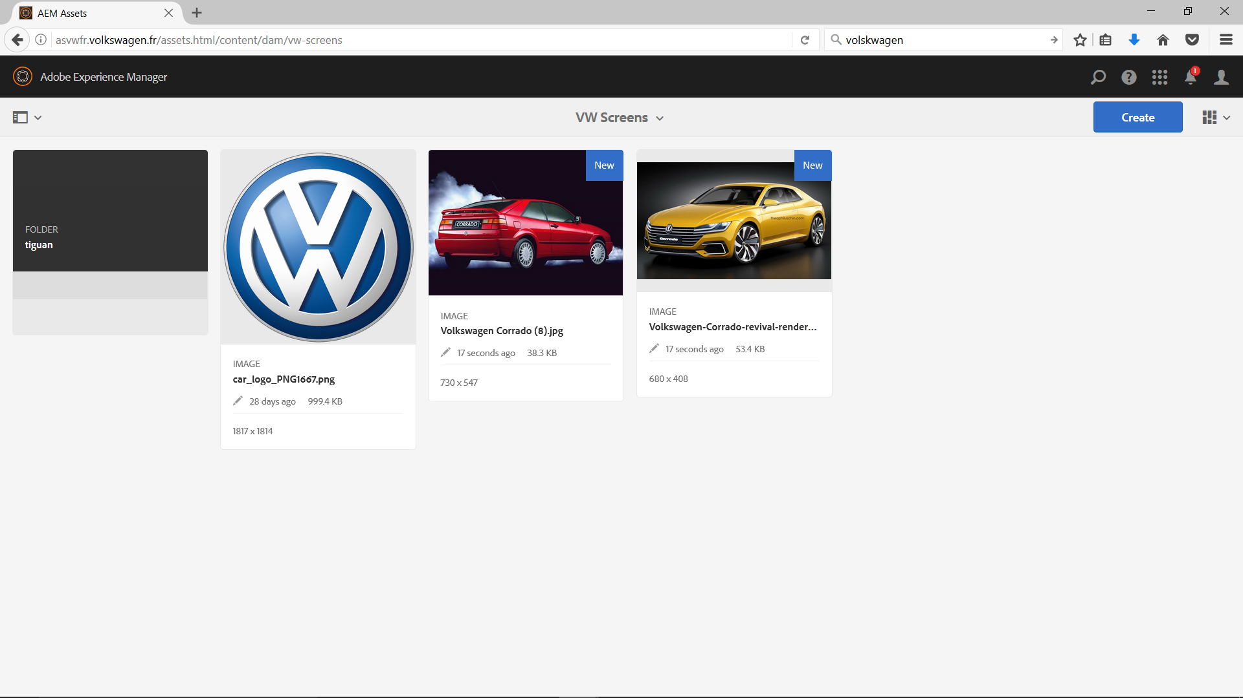

Slide 9
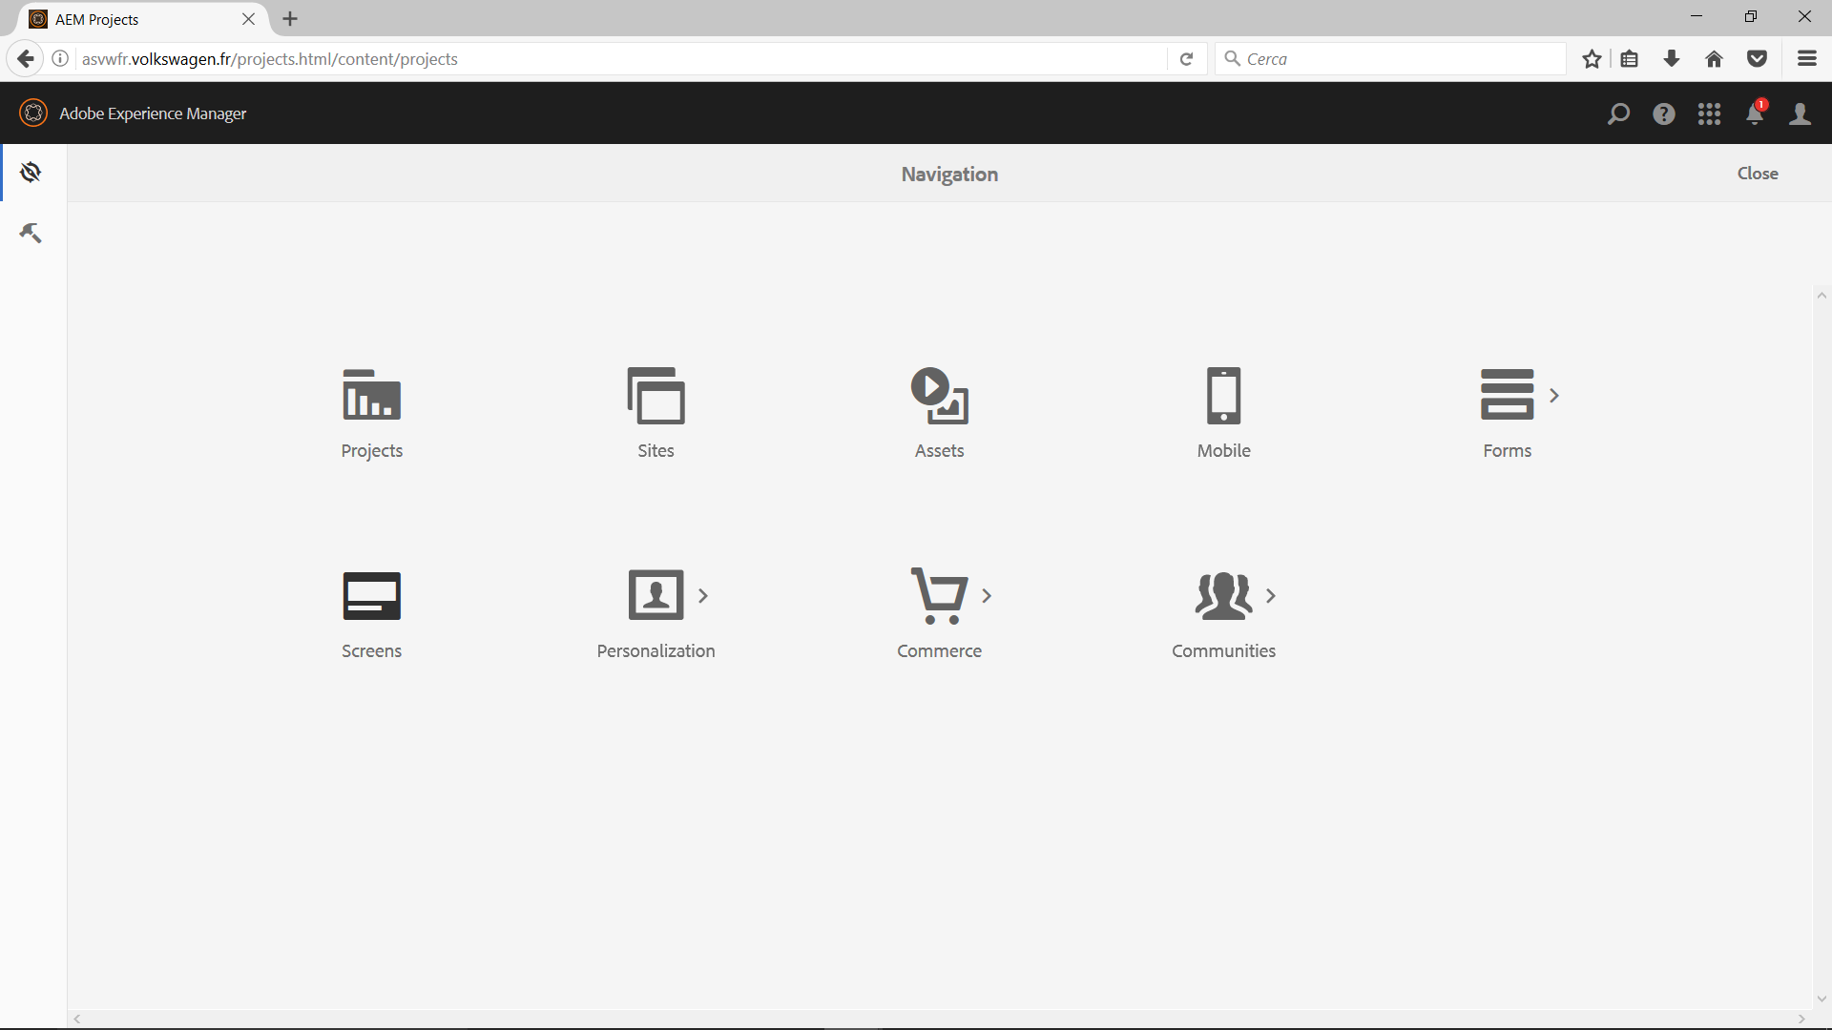
Click
Click

Slide 10
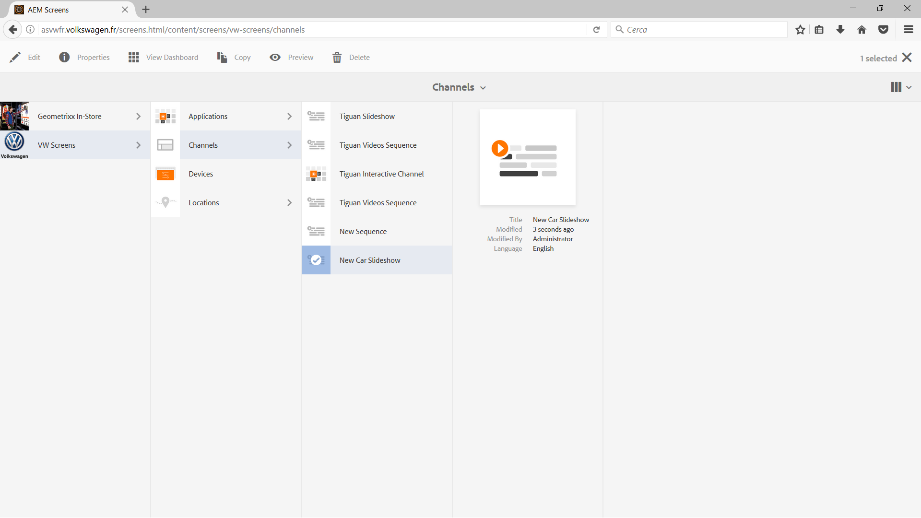
Click
Select

Slide 11
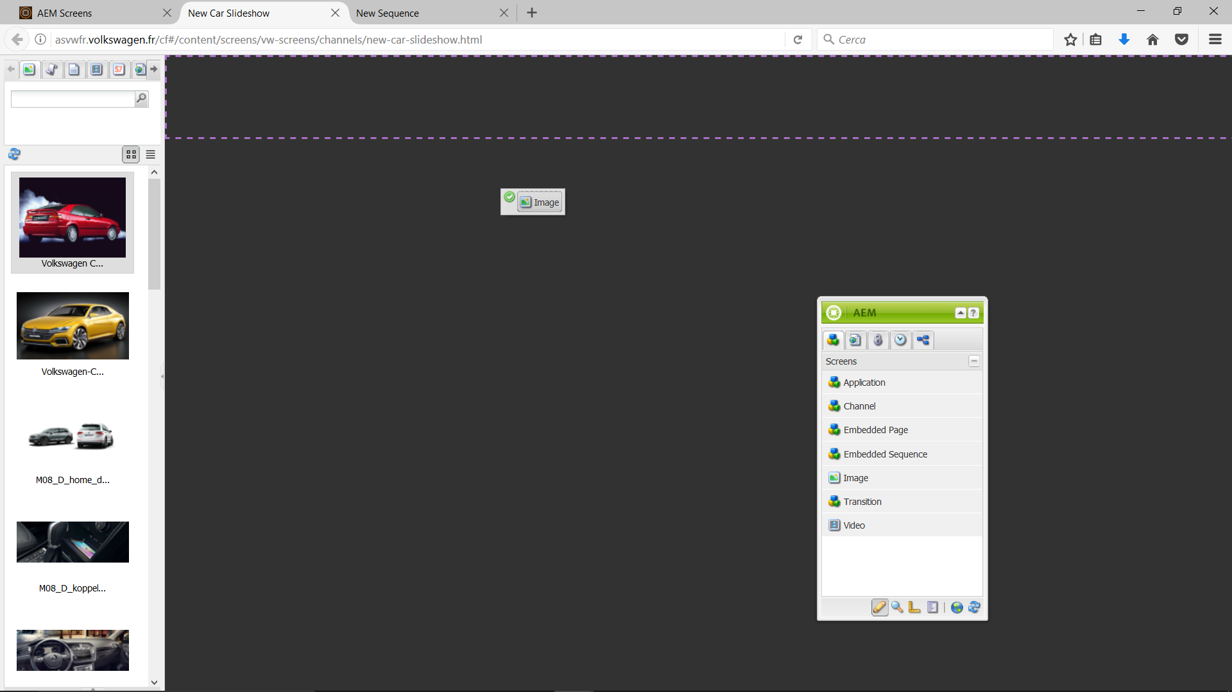
Drag & Drop

Slide 12
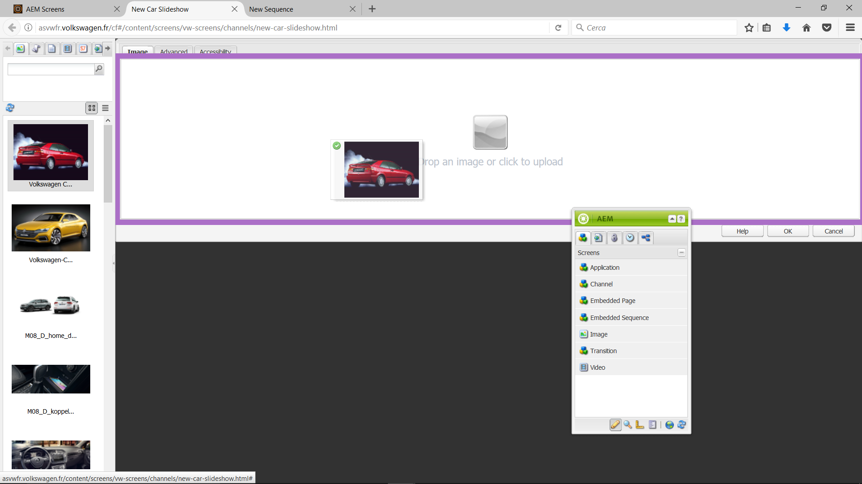
Drag & Drop

Slide 13
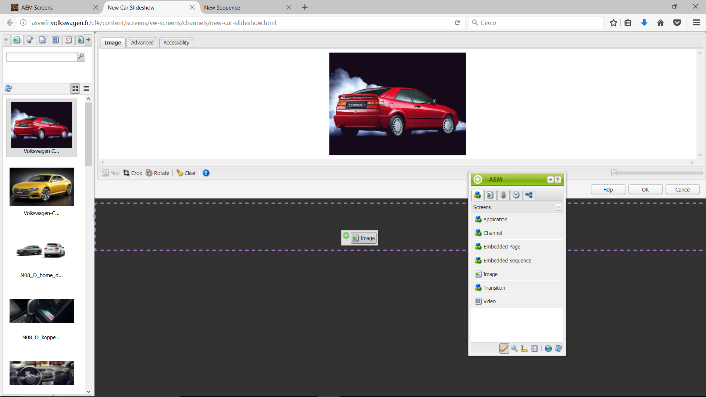
Editor
Drag & Drop

Slide 14
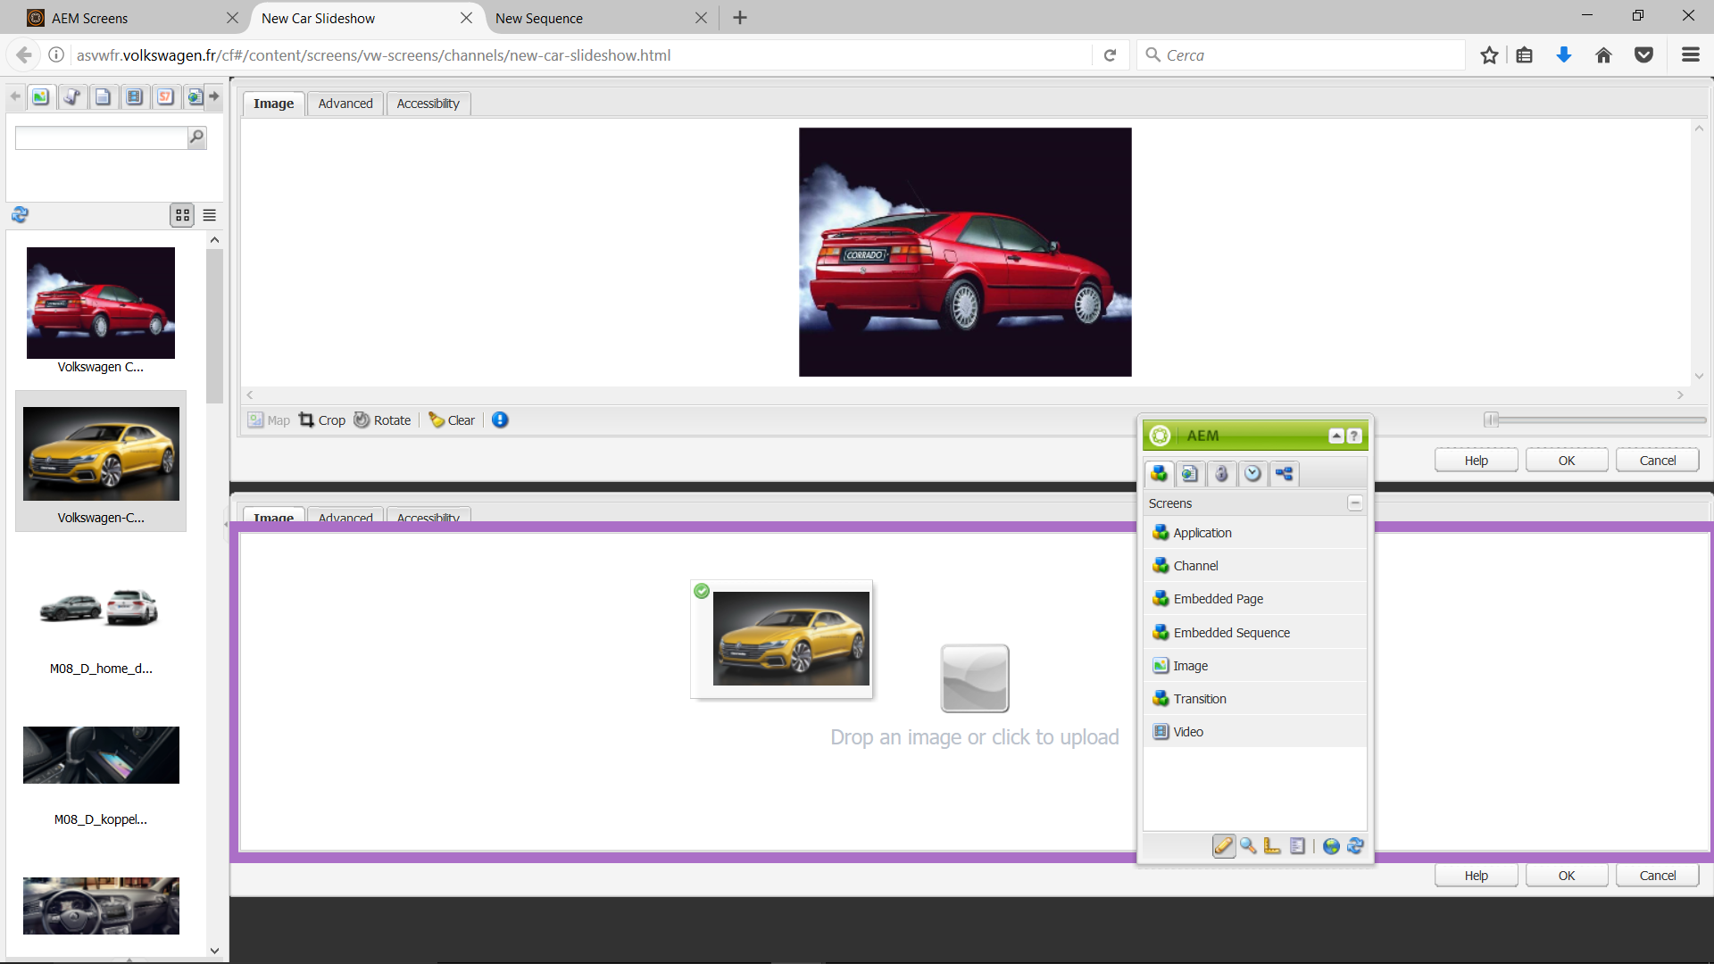
Drag & Drop

Slide 15
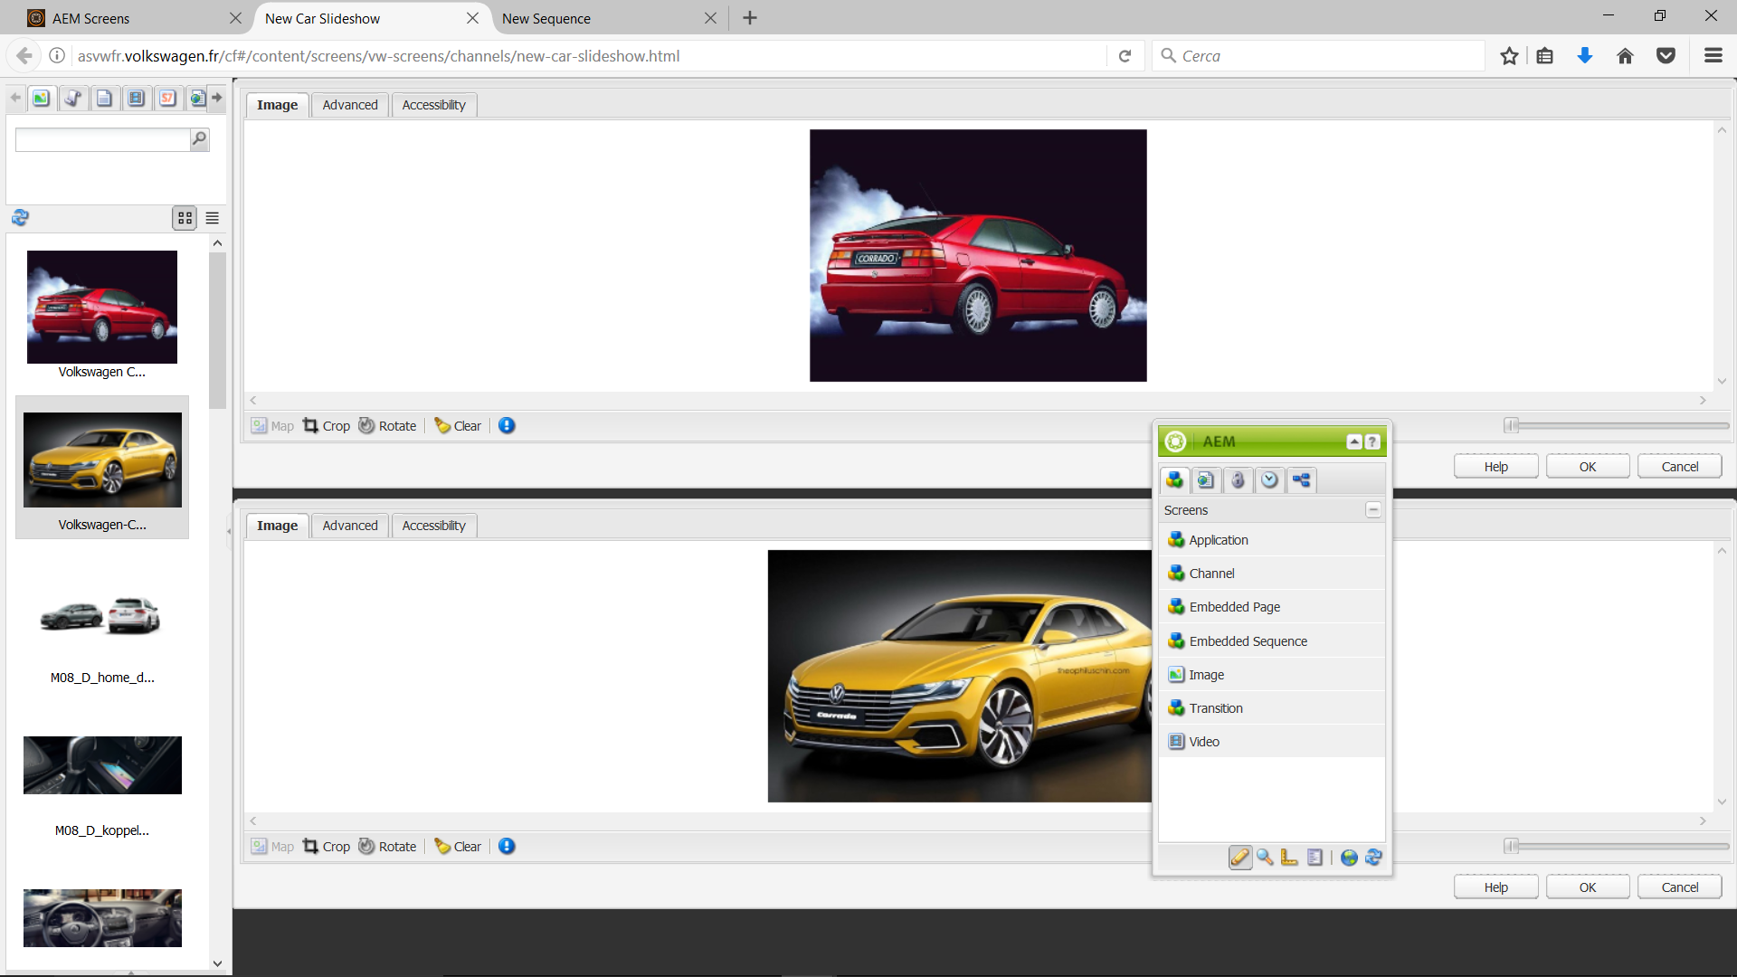
Click
Click

Slide 16
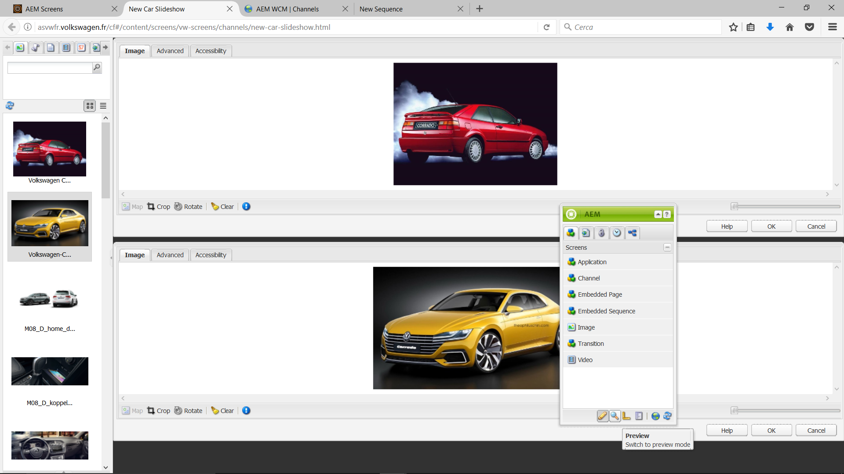
Click

Slide 17
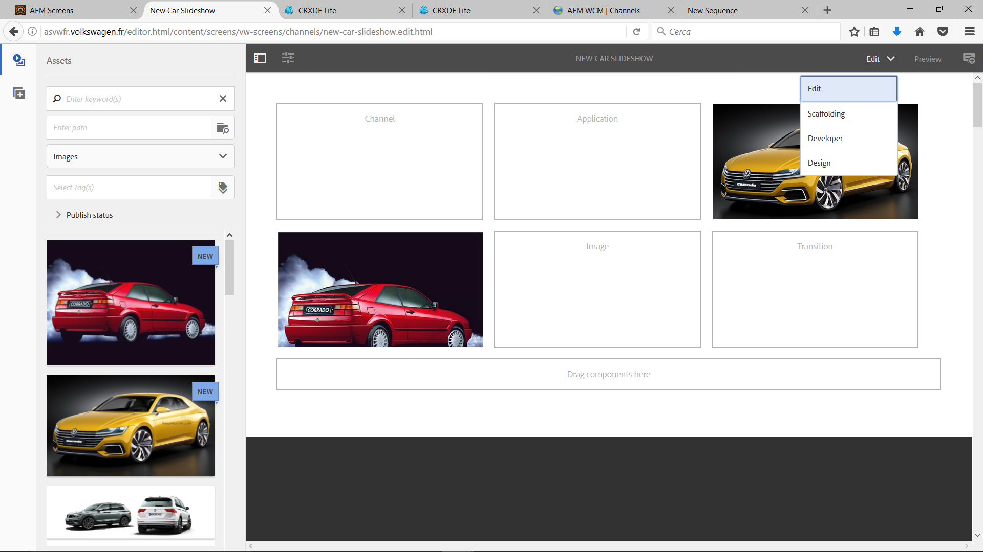
Editor
Click
Drag & Drop
Drag & Drop
Click

Slide 18
Adobe Experience Manager 6.2 Screens Authoring Capabilites
https://docs.adobe.com/docs/en/aem/6-2/author/screens.html

Slide 19
Adobe Experience Manager 6.2 Authoring Pages
https://docs.adobe.com/docs/en/aem/6-2/author/page-authoring.html

